Slide 1
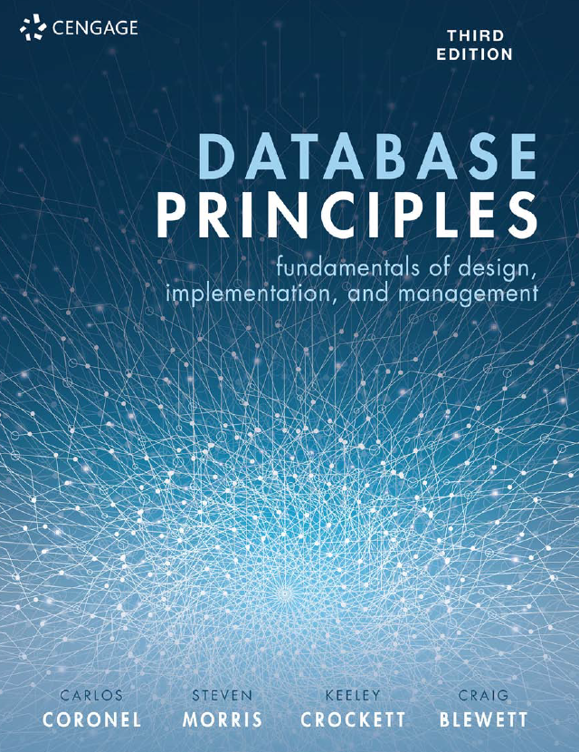
Database Principles Fundamentals of Design, Implementation, and Management
Carlos Coronel, Steven Morris,
Keeley Crockett, Craig Blewett
CHAPTER 3
RELATIONAL MODEL CHARACTERISTICS

Slide 2
In this chapter, you will learn:
That the relational database model takes a logical view of data
The relational model’s basic components are relations implemented through tables in a relational DBMS
How relations are organised in tables composed of rows (tuples) and columns (attributes)

Slide 3
In this chapter, you will learn (continued):
About relational database operators, the data dictionary, and the system catalog
How data redundancy is handled in the relational database model
Why indexing is important

Slide 4
A Logical View of Data
Relational model
Enables programmer to view data logically rather than physically
Table
Has advantages of structural and data independence
Resembles a file from conceptual point of view
Easier to understand than its hierarchical and network database predecessors

Slide 5
What is a Relation?
The concept of a relation is modelled on a mathematical construct
In mathematics,a relation is formally defined as:
Given a number of sets D1, D2, ....., Dn (which are not necessarily distinct), R is a relation on these n sets,it is a set of tuples each of which has its first element from D1, second element form D2, and so on.

Slide 6
Example of a Relation
Assume we have two sets (n =2), one of student’s last names (STU_LNAME) and one of the department codes (DEPT_CODE) where they have enrolled.
STU_LNAME {Ndlovu, Smithson, Le Roux, Ismall}
DEPT_CODE {BIOL, CIS, EDU}
Then a relation can be defined over the sets STU_LNAME and DEPT_CODE as:
R = {(Ndlovu, BIOL), (Smithson, CIS),(Le Roux, EDU),(Ismall, EDU)}

Slide 7
Tables and Relations
Table: two-dimensional structure composed of rows and columns
Contains group of related entities = an entity set
Terms entity set and table are often used interchangeably

Slide 8
Tables and Relations (continued)
Table also called a relation because the relational model’s creator, Codd, used the term relation as a synonym for table
Think of a table as a persistent relation:
A relation whose contents can be permanently saved for future use

Slide 9
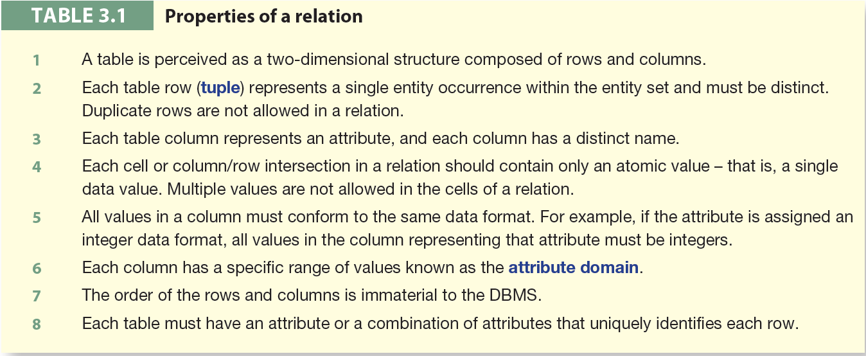
Properties of a Relation

Slide 10
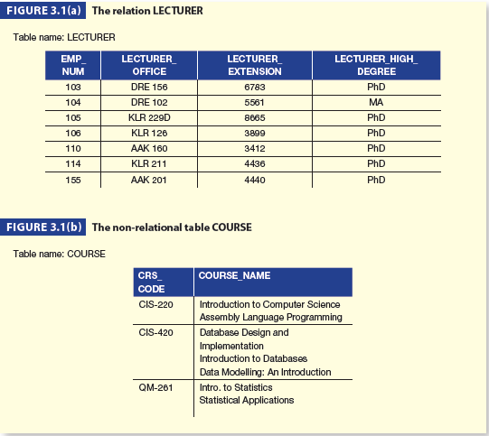
Example Relation

Slide 11
Attributes and Domains
Each attribute is a named column within the relational table and draws its values from a domain.
The domain of values for an attribute should contain only atomic values and any one value should not be divisible into components.
No attributes with more than one value are allowed.

Slide 12
Degree and Cardinality
Degree and cardinality are two important properties of the relational model.
A relation with N columns and N rows is said to be of degree N and cardinality N.
The degree of a relation is the number of its attributes and the cardinality of a relation is the number of its tuples.
The product of a relation’s degree and cardinality is the number of attribute values it contains.

Slide 13
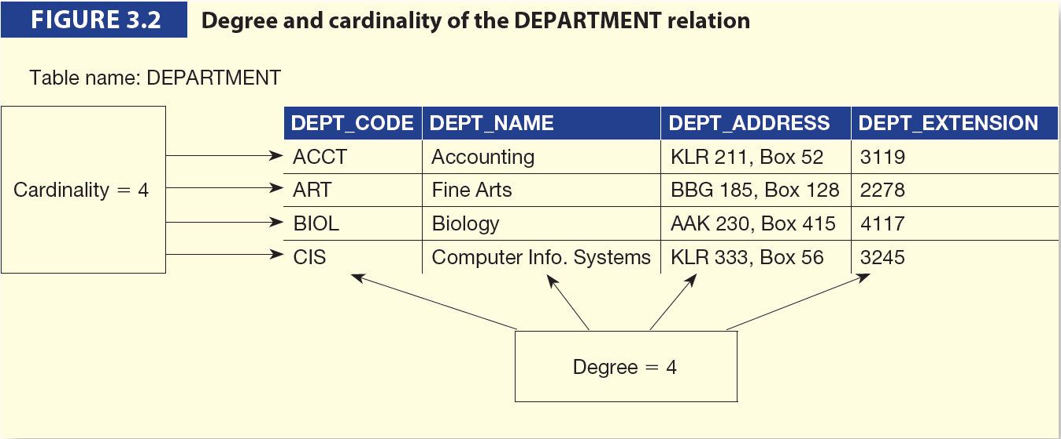
Degree and Cardinality

Slide 14
Relational Schema
A relational schema is a textual representation of the database tables, where each table is described by its name followed by the list of its attributes in parentheses.
A relational schema R can be formally defined as
R={a1, a2,...,an} where a1…an are a set of attributes belonging to the relation.

Slide 15
Keys
Consists of one or more attributes that determine other attributes
Primary key (PK) is an attribute (or a combination of attributes) that uniquely identifies any given entity (row)
Key’s role is based on determination
If you know the value of attribute A, you can look up (determine) the value of attribute B

Slide 16
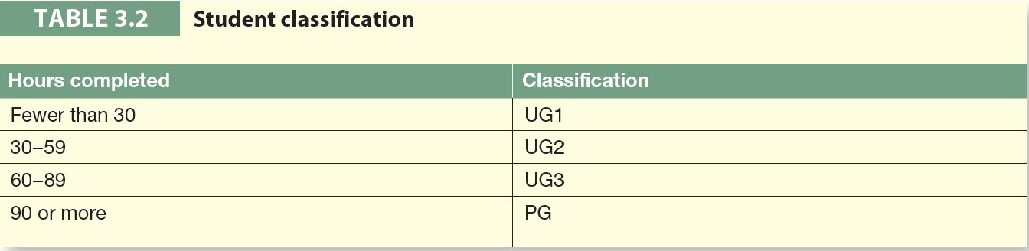
Keys (continued)

Slide 17
Relational Database Keys
Composite key
Composed of more than one attribute
Key attribute
Any attribute that is part of a key
Superkey
Any key that uniquely identifies each row
Candidate key
A superkey without redundancies

Slide 18
Keys (continued)
Nulls:
No data entry
Not permitted in primary key
Should be avoided in other attributes
Can represent
An unknown attribute value
A known, but missing, attribute value
A “not applicable” condition
Can create problems when functions such as COUNT, AVERAGE, and SUM are used
Can create logical problems when relational tables are linked

Slide 19
Keys (continued)
Controlled redundancy:
Makes the relational database work
Tables within the database share common attributes that enable the tables to be linked together
Multiple occurrences of values in a table are not redundant when they are required to make the relationship work
Redundancy exists only when there is unnecessary duplication of attribute values

Slide 20
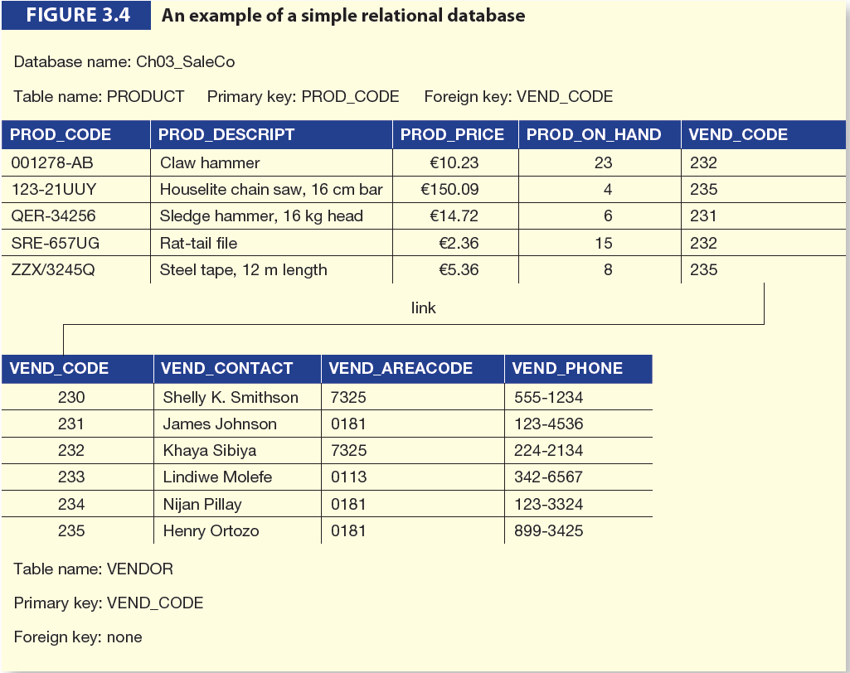
Keys (continued)

Slide 21
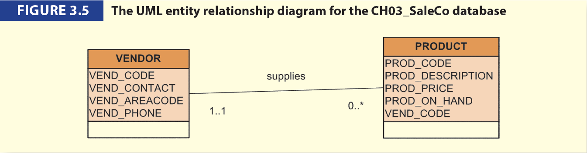
Keys (continued)

Slide 22
Keys (continued)
Foreign key (FK)
An attribute whose values match primary key values in the related table
Referential integrity
FK contains a value that refers to an existing valid tuple (row) in another relation
Secondary key
Key used strictly for data retrieval purposes

Slide 23
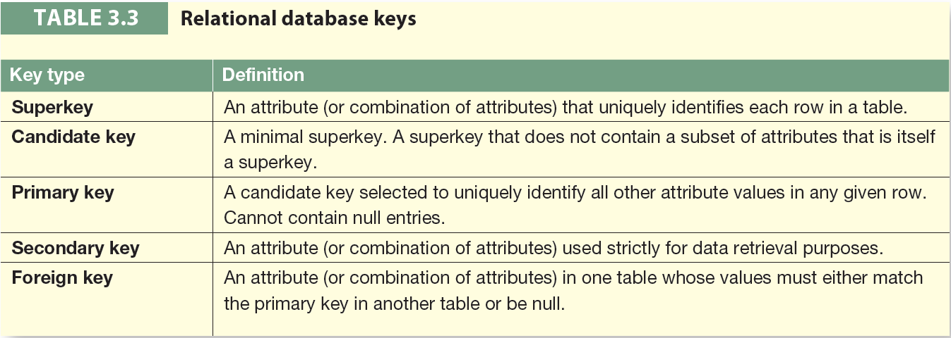
Keys (continued)

Slide 24
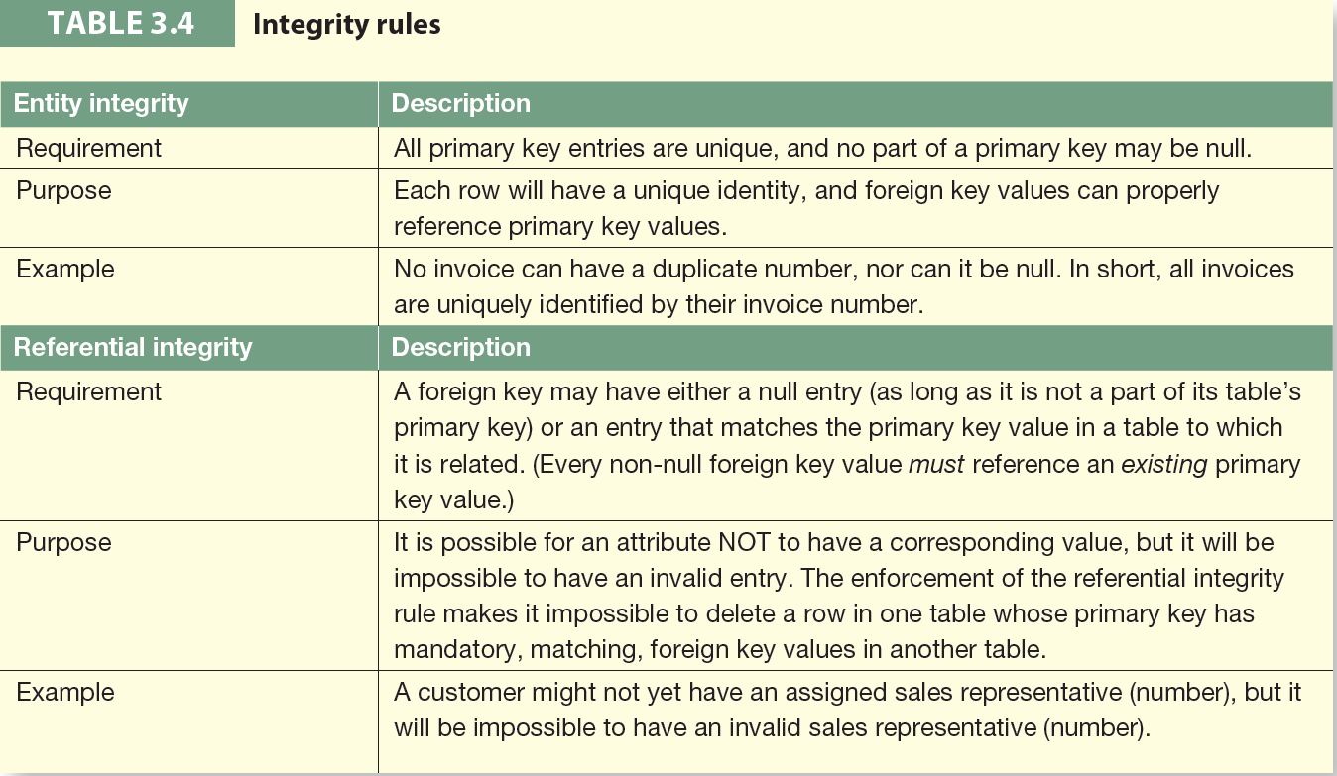
Integrity Rules

Slide 25
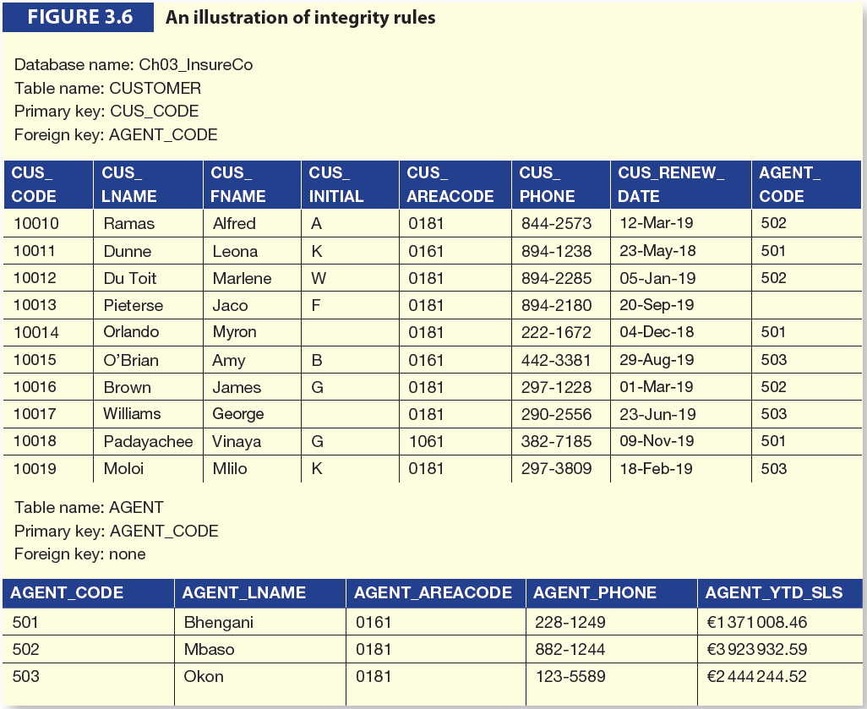
Integrity Rules (continued)

Slide 26
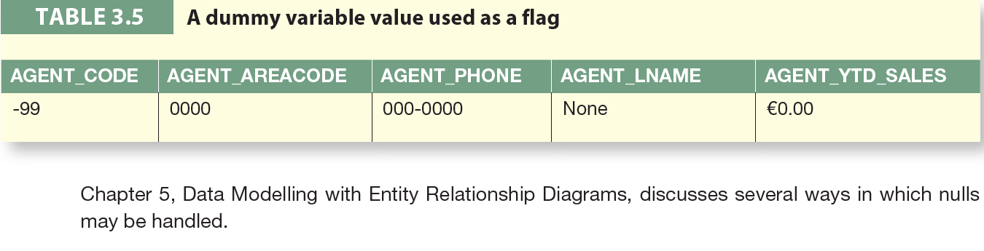
Integrity Rules (continued)

Slide 27
The Data Dictionary and System Catalog
Data dictionary
Provides detailed accounting of all tables found within the user/designer-created database
Contains (at least) all the attribute names and characteristics for each table in the system
Contains metadata—data about data
Sometimes described as “the database designer’s database” because it records the design decisions about tables and their structures

Slide 28
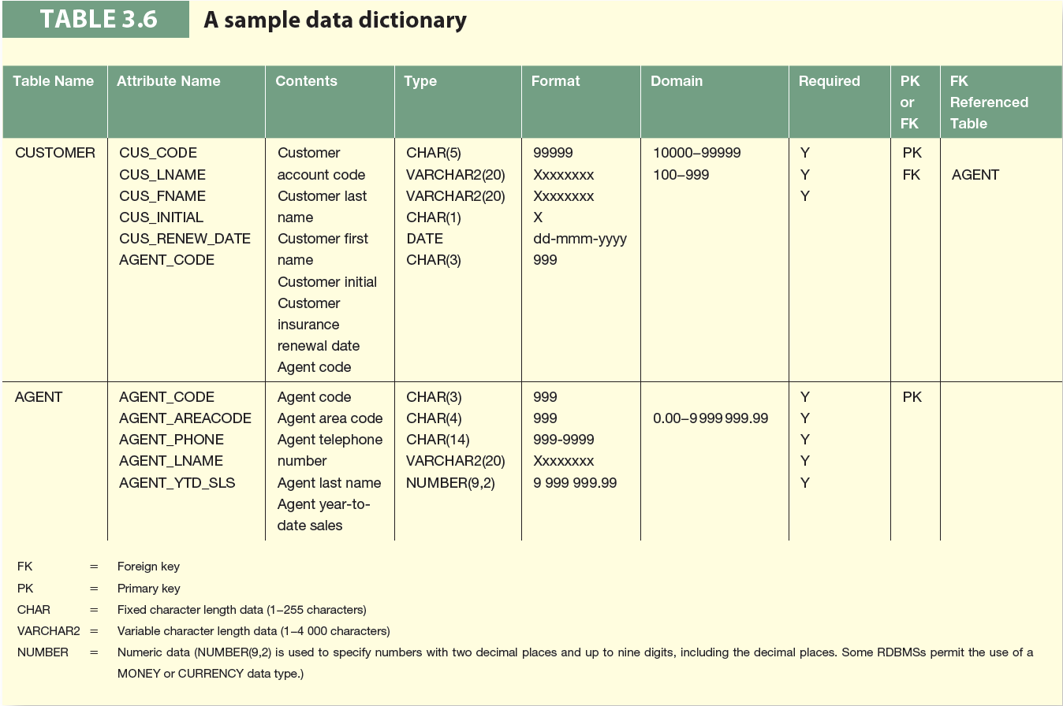
A Sample Data Dictionary

Slide 29
The Data Dictionary and System Catalog (continued)
System catalog
Contains metadata
Detailed system data dictionary that describes all objects within the database
Terms “system catalog” and “data dictionary” are often used interchangeably
Can be queried just like any user/designer-created table

Slide 30
Relationships within the Relational Database
1:* relationship
Relational modeling ideal
Should be the norm in any relational database design
1:1 relationship
Should be rare in any relational database design
*:* relationships
Cannot be implemented as such in the relational model
*:* relationships can be changed into two 1:* relationships

Slide 31
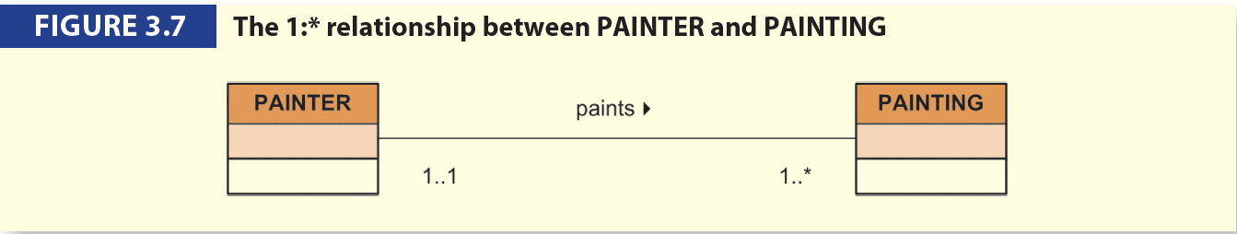
The 1:* Relationship
Relational database norm
Found in any database environment

Slide 32
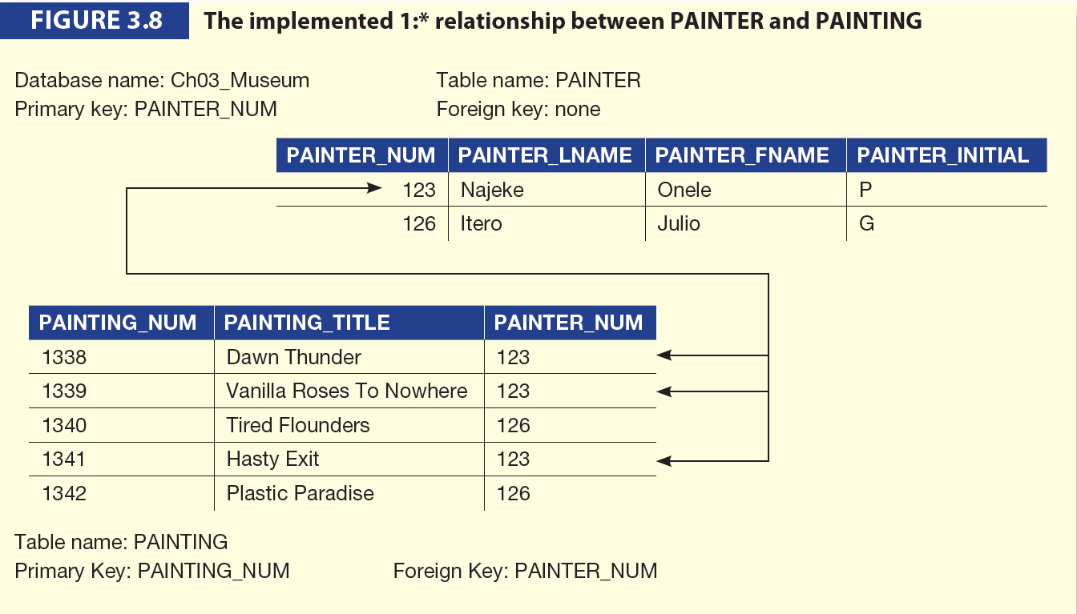
The 1:* Relationship (continued)

Slide 33
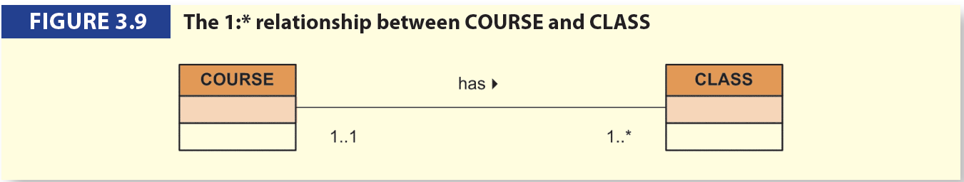
The 1:* Relationship (continued)

Slide 34

The 1:* Relationship (continued)

Slide 35
The 1:1 Relationship
One entity can be related to only one other entity, and vice versa
Sometimes means that entity components were not defined properly
Could indicate that two entities actually belong in the same table
As rare as 1:1 relationships should be, certain conditions absolutely require their use

Slide 36
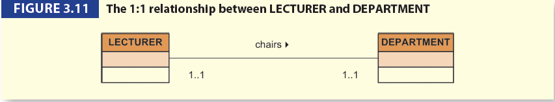
The 1:1 Relationship (continued)

Slide 37
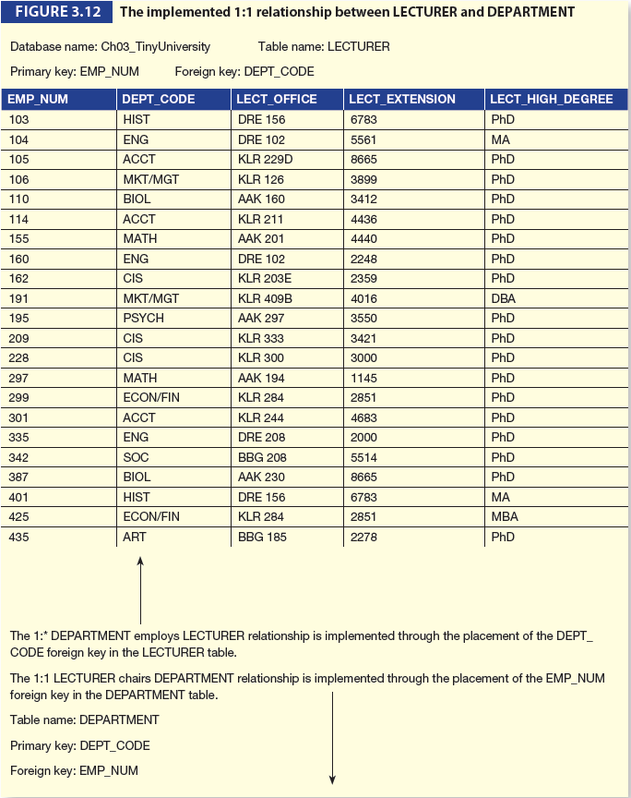
The 1:1 Relationship (continued)

Slide 38
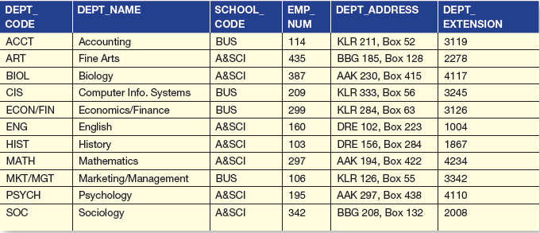
The 1:1 Relationship (continued)

Slide 39
The *:* Relationship
Can be implemented by breaking it up to produce a set of 1:* relationships
Can avoid problems inherent to *:* relationship by creating a composite entity or bridge entity

Slide 40
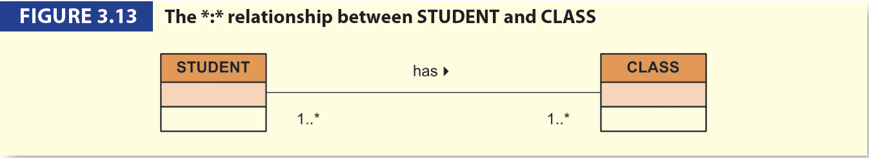
The *:* Relationship (continued)

Slide 41
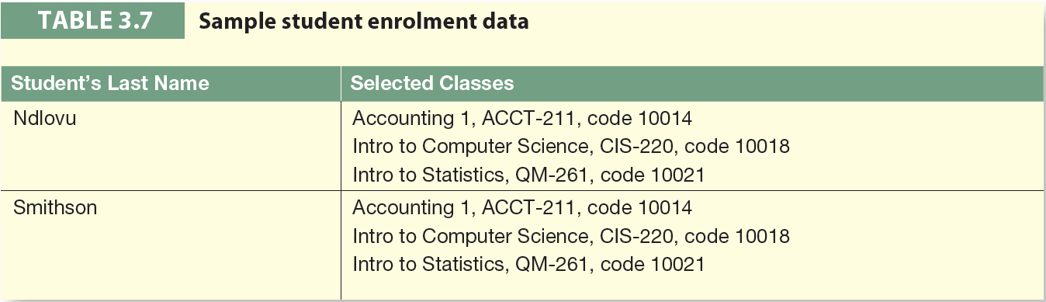
The *:* Relationship (continued)

Slide 42
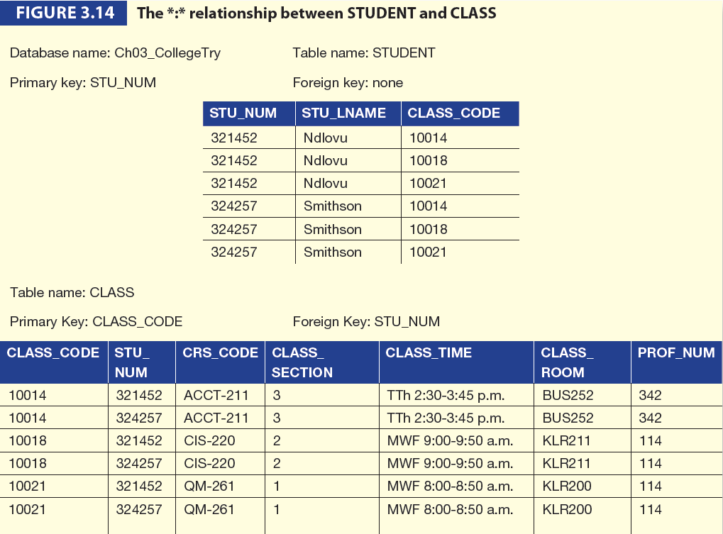
The *:* Relationship (continued)

Slide 43
The *:* Relationship (continued)
Implementation of a composite entity
Yields required *:* to 1:* conversion
Composite entity table must contain at least the primary keys of original tables
Linking table contains multiple occurrences of the foreign key values
Additional attributes may be assigned as needed

Slide 44
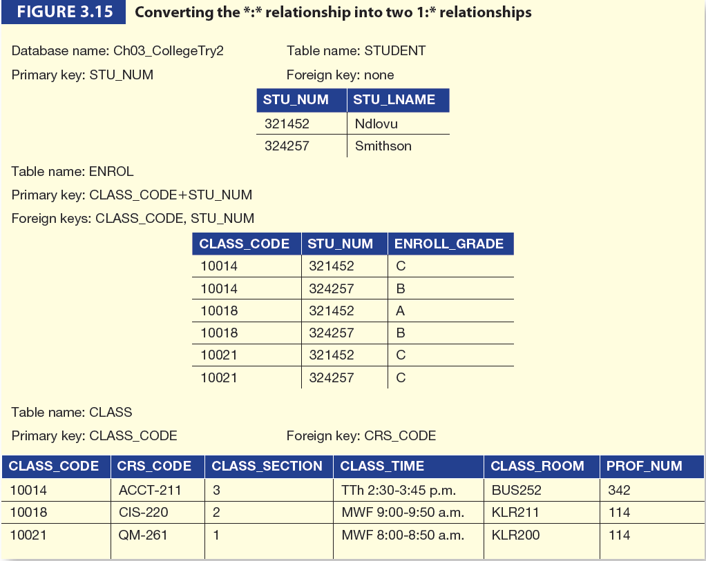
The *:* Relationship (continued)

Slide 45
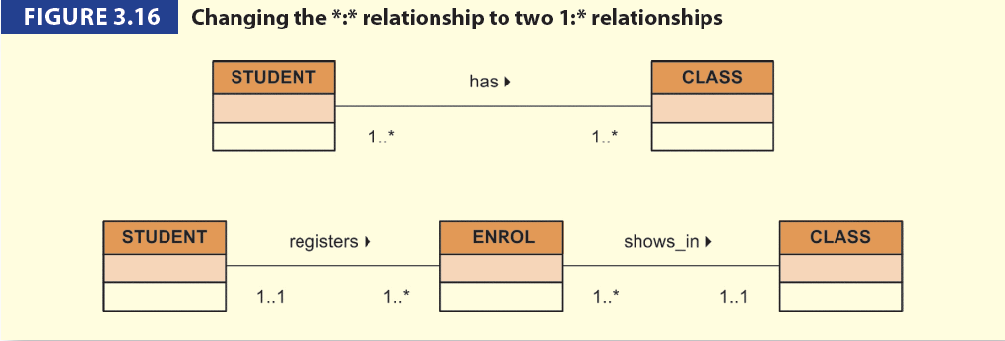
The *:* Relationship (continued)

Slide 46
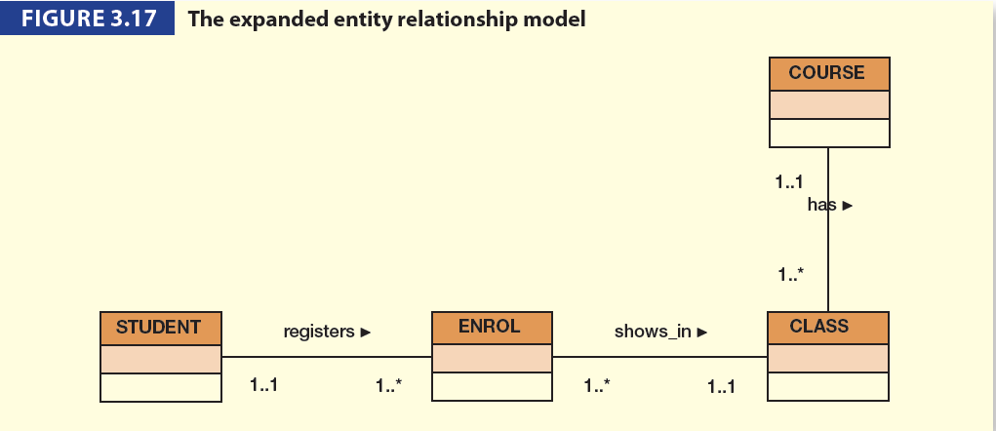
The *:* Relationship (continued)

Slide 47
Data Redundancy Revisited
Data redundancy leads to data anomalies
Such anomalies can destroy the effectiveness of the database
Foreign keys
Control data redundancies by using common attributes shared by tables
Crucial to exercising data redundancy control
Sometimes, data redundancy is necessary

Slide 48
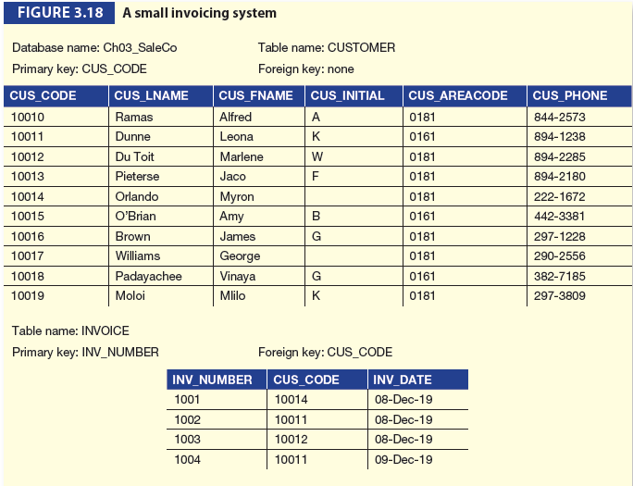
Data Redundancy Revisited (continued)

Slide 49
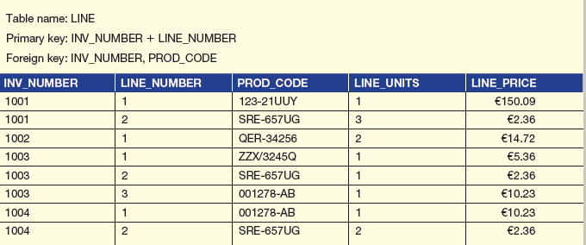
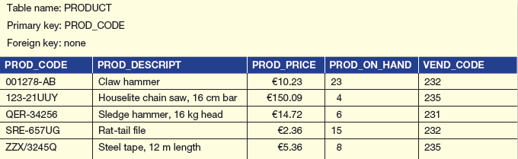
Data Redundancy Revisited (continued)

Slide 50
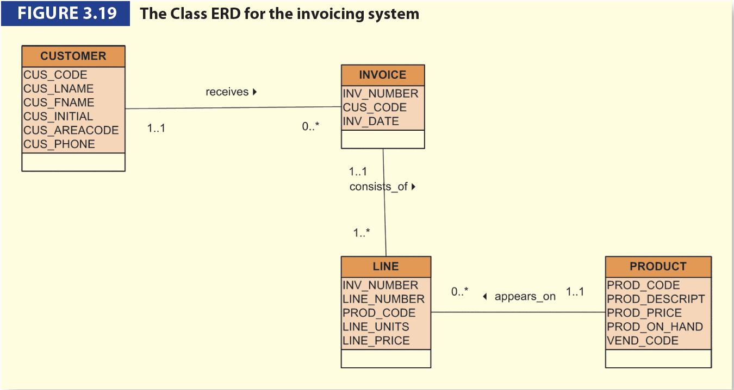
Data Redundancy Revisited (continued)

Slide 51
Indexes
Arrangement used to logically access rows in a table
Index key
Index’s reference point
Points to data location identified by the key
Unique index
Index in which the index key can have only one pointer value (row) associated with it
Each index is associated with only one table

Slide 52
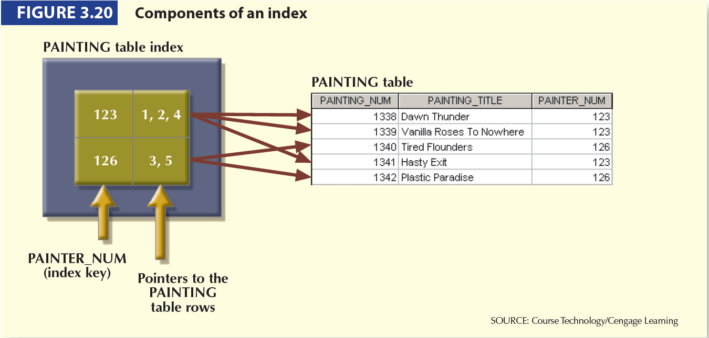
Indexes (continued)

Slide 53
Codd’s Relational Database Rules
In 1985, Codd published a list of 12 rules to define a relational database system
The reason was the concern that many vendors were marketing products as “relational” even though those products did not meet minimum relational standards

Slide 54
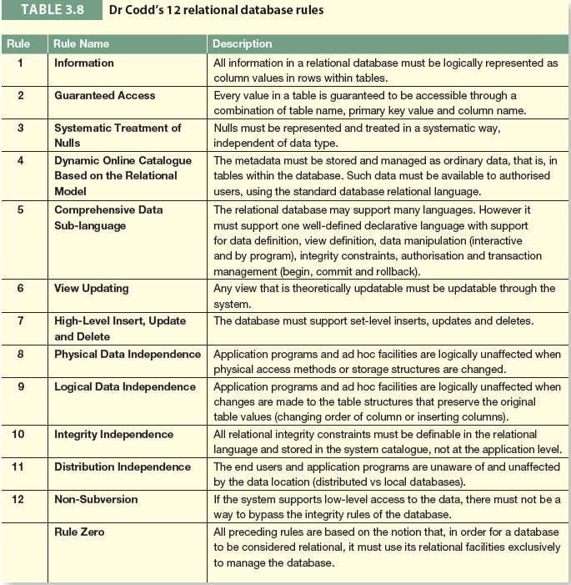
Codd’s Relational Database Rules (Continued)

Slide 55
Summary
Relations are basic building blocks of a relational database.
Keys are central to the use of relational tables
Keys define functional dependencies
Superkey
Candidate key
Primary key
Secondary key
Foreign key

Slide 56
Summary (continued)
Each table row must have a primary key which uniquely identifies all attributes
Tables can be linked by common attributes. Thus, the primary key of one table can appear as the foreign key in another table to which it is linked
Good design begins by identifying appropriate entities and attributes and the relationships among the entities. Those relationships (1:1, 1:*, and *:*) can be represented using ERDs.

